Slide 1
Quick sort
Presentation by
Aditee verma
Ameya pingulkar

Slide 2
introduction
worst-case running time of theta(n²)
Despite slow worst case running time - Best practical choice for sorting – efficient on the average
Expected running time is theta(n log n)
No particular input elicits its worst-case behavior
Works well in virtual-memory environments

Slide 3
description
Uses divide-and-conquer paradigm
Divide: Partition (rearrange) the array Into two (possibly empty) subarrays such that each element is less than or equal to each element. Compute the index q as part of this partitioning procedure
Conquer: Sort the two subarrays by recursive calls to quicksort
Combine: Because the subarrays are already sorted, no work is needed to combine them: the entire array is now sorted.

Slide 4
Procedure
QUICKSORT(A,p,r)
if p < r
q = PARTITION (A,p,r)
QUICKSORT (A,p,q-1)
QUICKSORT (A,q+1,r)
To sort an entire array A, the initial call is QUICKSORT(A,1,A.length)

Slide 5
Hoare partition correctness
Quicksort procedure was invented by tony hoare in 1959 while in the Soviet Union, as a visiting student at Moscow State University.
At that time, Hoare worked in a project on machine translation for the National Physical Laboratory. As a part of the translation process, he needed to sort the words of Russian sentences prior to looking them up in a Russian-English dictionary that was already sorted in alphabetic order on magnetic tape.
After recognizing that his first idea, insertion sort, would be slow, he quickly came up with a new idea that was Quicksort.
He wrote a program in Mercury Autocode for the partition but couldn't write the program to account for the list of unsorted segments.
On return to England, he was asked to write code for Shellsort as part of his new job. Hoare mentioned to his boss that he knew of a faster algorithm and his boss bet sixpence that he didn't. His boss ultimately accepted that he had lost the bet.
Later, Hoare learned about ALGOL and its ability to do recursion that enabled him to publish the code in Communications of the Association for Computing Machinery, the primere computer science journal of the time.

Slide 6
Hoare partition correctness
Quicksort procedure was invented by hoare in 1959
HOARE-PARTITION(A,p,r)
x = A[p]
i = p - 1
j = r + 1
while TRUE
repeat
j = j - 1
until A[j] <= x
repeat
i = i + 1
until A[i] => x
if i < j
exchange A[i] with A[j]
else return j

Slide 7
Lamuto’s partition paradigm
Later introduces N. lomuto another partition paradigm
PARTITION(A,p,r)
x = A[r]
I = p - 1
for j = p to r - 1
if A[j] <= x
I = I + 1
exchange A[i] with A[j]
exchange A[i+1] with A[r]
Return I + 1

Slide 8
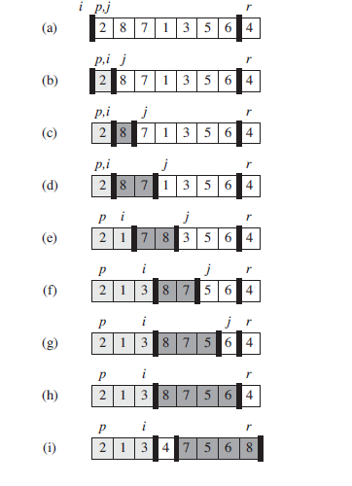
Partitioning

Slide 9


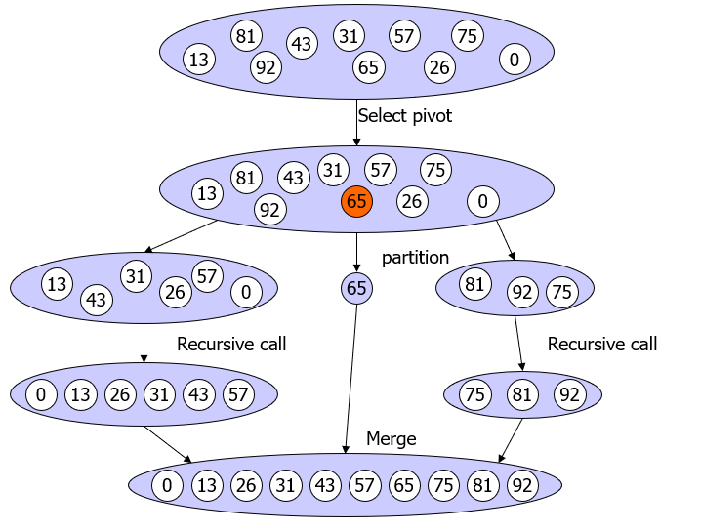
Quicksort example

Slide 10
history
Robert Sedgewick's Ph.D. thesis in 1975 is considered a milestone in the study of Quicksort where he resolved many open problems related to the analysis of various pivot selection schemes including Samplesort, adaptive partitioning by Van Emden as well as derivation of expected number of comparisons and swaps.
Bentley and McIlroy incorporated various improvements for use in programming libraries, including a technique to deal with equal elements and a pivot scheme known as pseudomedian of nine, where a sample of nine elements is divided into groups of three and then the median of the three medians from three groups is chosen.
Jon Bentley described another simpler and compact partitioning scheme in his book Programming Pearls that he attributed to Nico Lomuto. Later Bentley wrote that he used Hoare's version for years but never really understood it but Lomuto's version was simple enough to prove correct. Bentley described Quicksort as the "most beautiful code I had ever written" in the same essay.

Slide 11
history
Lomuto's partition scheme was also popularized by the textbook Introduction to Algorithms although it is inferior to Hoare's scheme because it does three times more swaps on average and degrades to theta(n²) runtime when all elements are equal.
Quick sort analysis(worst case & expected running time) is given by Avrim blum
In 2009, Vladimir Yaroslavskiy proposed the new dual pivot Quicksort implementation. In the Java core library mailing lists, he initiated a discussion claiming his new algorithm to be superior to the runtime library’s sorting method, which was at that time based on the widely used and carefully tuned variant of classic Quicksort by Bentley and McIlroy.
Yaroslavskiy’s Quicksort has been chosen as the new default sorting algorithm in Oracle’s Java 7 runtime library after extensive empirical performance tests.

Slide 12
References
Introduction to algorithms by Thomas h. cormen, Charles e. leiserson, Ronald l. rivest, Clifford stein
https://en.wikipedia.org/wiki/Quicksort

Slide 13
Thank you ! (Any questions? Ask suzanna :-D )

